Slide 1
17. Finish Heap sort; Balanced Trees
ECE 309
Dr. James Tuck

Slide 2
Objectives
Describe the heapsort algorithm for sorting an array using a max-heap.
Implement heapsort using a static function.
Define balanced tree and explain the benefits of searching, inserting, and removing on one.
Compute the balance factor of a sub-tree.
Describe and implement right rotation and left rotation.

Slide 3
The heapify operation
The heapify operation converts an unsorted array into a legal max-heap.
heapify() {
m = get the last used internal node index // everything after is a leaf
while( m >= 0 ) {
MaxHeapPercolateDown(m);
m--;
}
}

Slide 4
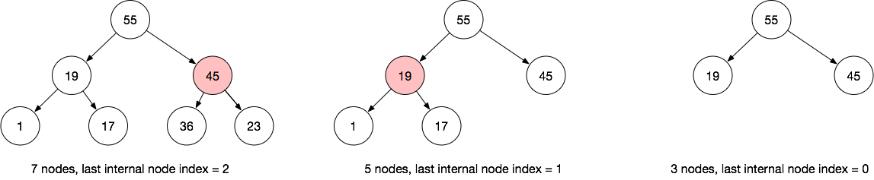
Last internal node
The last internal node can be calculated based on the number of entries in the max-heap.
Last internal node index = floor(N/2) - 1, where N is number of nodes.

Slide 5
Back to heapsort
First, heapify the array - change the unsorted array into a legal max-heap
Then, remove the max item one at a time to sort the array in reverse, from greatest to least

Slide 6
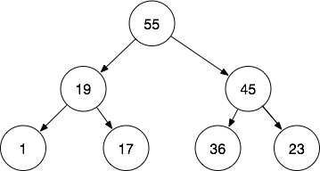
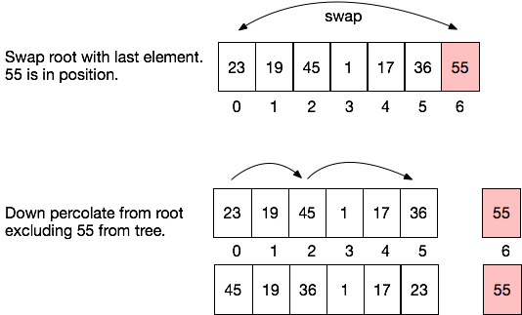

Example of heapsort
Heapified array.

Slide 7
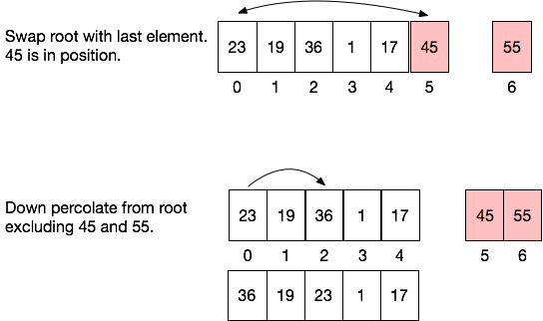
Example of heapsort

Slide 8
Heapsort pseudocode
Heapsort(numbers, numbersSize) {
// Copy numbers array into MaxHeap object heapify(); for (i = nextIndex - 1; i > 0; i--) {
// move max item out of the heap; clever trick -- put it at the end
// of the array to avoid allocating new memory val = MaxHeapRemove();
numbers[i] = val; } }

Slide 9
Heapsort implementation
Add support for heapsort to the MaxHeap class.
Add a constructor that allows us to pass in our own integer array for sorting that gets heapified on construction.
Problem: after sorting, the heap is “empty”; it’s weird for heapsort to be a member function

Slide 10
Heapsort implementation
Make heapsort a static member function of MaxHeap.
static functions are global functions and are not called on an instance of the object
We can call the function to sort any array without making a MaxHeap object first
Since it’s part of MaxHeap, we can still leverage private member functions to complete the sort

Slide 11
Heapsort implementation
class Maxheap {
... //implementation from last class
public:
Maxheap(int *a, int size, int length = 0)
: heapArray(a), heapArraySize(size), nextIndex(length) {
int m = length / 2 - 1; // same as ((length-1)-1)/2, parent of last node
while (m >= 0) {
percolate_down(m, length);
m--;
}
}
static void sort(int *array, int size); // global function
};

Slide 12
Heapsort implementation
void Maxheap::sort(int *array, int size) {
Maxheap maxheap(array, size, size); // construct helper object
// after construction, array is heapified
for (m = size - 1; m > 0; m--) {
int ref;
maxheap.remove(ref); // remove maximum
array[m] = ref; // copy to end of array;
}
// array is sorted, caller still has access to array
// maxheap object is destroyed
}

Slide 13
Heapsort example
int *array = new int[10];
for (int j = 0; j < 10; j++)
array[j] = rand() % 100;
MaxHeap::sort(array, 10); // Must put class name in front of static function name!
for (int j = 0; j < 10; j++)
printf("%d ", array[j]);
printf("\n");

Slide 14
Time complexity of heap operations
Operation (length N) | Big-O Time Complexity | Explanation
Percolation up/down | O(log N) | May require traversing all levels of the tree, so the cost is determined by tree height (H). Hence, O(log N)
insert | O(log N) | We copy the item to the last free index, thats O(1). But, then it’s percolated up, which is O(log N).
remove | O(log N) | Finding the root is fast (O(1)). But, we swap it for the last index and down percolate, that is O(log N).
heapify | O(N log N) | We must visit N/2 nodes and perform down percolation. N/2 * log N => O(N log N)
heapsort | O(N log N) | Heapify is O(N log N). Then, removing the max item N times and down percolating is also O(N log N). N log N + N log N => O(N log N).

Slide 15
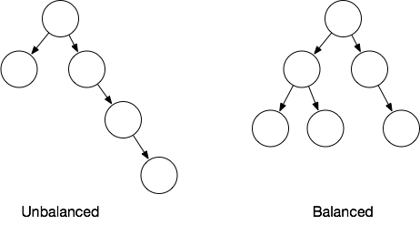
Binary Search Trees
BSTs are efficient to search as long as they are relatively balanced.
Our BST algorithm does not ensure balance.

Slide 16
AVL: a balanced tree
Key idea: we can enforce balance when we insert or remove items from the tree by judiciously re-organizing the tree.

Slide 17
Height balance
A BST is height balanced if for any node in the tree the heights of the left and right sub-trees differ by 0 or 1.
Balance Factor (n) = Height(n’s left sub-tree) - Height(n’s right sub-tree)
We’ll assume that a null sub-tree has Height = -1

Slide 18
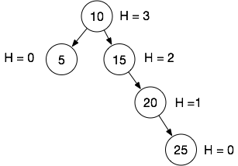
Calculate Balance Factor
Node | Height of Left Sub-tree | Height of Right Sub-tree | Balance Factor H(left)-H(right)
5 | -1 | -1 | 0
10 | H(5)=0 | H(15)=2 | -2
15 | -1 | H(20)=1 | -2
20 | -1 | H(25)=0 | -1
25 | -1 | -1 | 0
Remember, a null sub-tree has a Height = -1

Slide 19
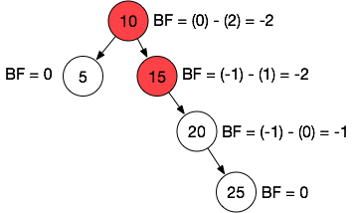
Calculate Balance Factor
Node | Height of Left Sub-tree | Height of Right Sub-tree | Balance Factor H(left)-H(right)
5 | -1 | -1 | 0
10 | H(5)=0 | H(15)=2 | -2
15 | -1 | H(20)=1 | -2
20 | -1 | H(25)=0 | -1
25 | -1 | -1 | 0
A balance factor of 0 or 1 is needed on all nodes to be considered height balanced. This tree is not balanced.

Slide 20
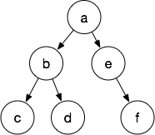
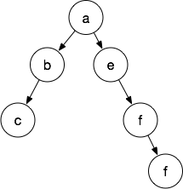
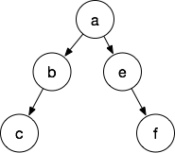
Example: determine if these trees are balanced

Slide 21
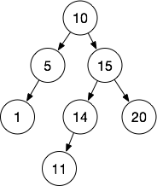
AVL trees are height balanced
AVL trees will always conform to height balance.
But, height balance is not minimal, it’s just a good heuristic.
An AVL’s height has been proven to be 1.5x the minimum: 1.5*(log₂ N)
Balanced, not minimal

Slide 22
Store height in each node
To make the balance factor calculation efficient, we can store the height in each node
class BTNode {
Public:
BTNode(int d)
:data(d),
left(nullptr),
right(nullptr), height(0) {}
int data;
BTNode *left;
BTNode *right;
BTNode *parent;
int height;
};
int balance_factor(BTNode *n) {
int left = -1, right = -1;
if(n==nullptr) return 0;
if(n->left)
left = n->left->height;
if(n->right)
right = n->right->height;
return left - right;
}

Slide 23
Compute the height of a sub-tree
int BinarySearchTree::computeHeight(BTNode *node) {
if (node->left == nullptr && node->right == nullptr)
node->height = 0;
else if (node->left && node->right == nullptr)
node->height = node->left->height + 1;
else if (node->left == nullptr && node->right)
node->height = node->right->height + 1;
else
node->height = std::max(node->right->height, node->left->height) + 1;
return node->height;
}

Slide 24
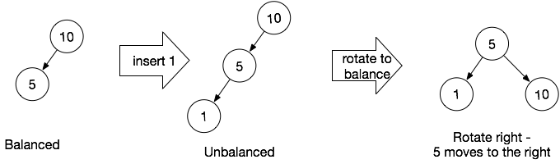
How do we keep a BST balanced?
If we insert into an unbalanced sub-tree, we rotate it.
A rotation is a local re-arrangement of nodes in the BST to achieve an acceptable balance factor.

Slide 25
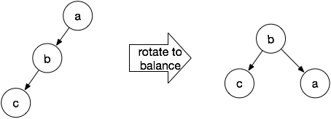
Right rotation
A right rotation moves nodes to the right. b moves up and replaces a, and a becomes the child of b.
In this case, b has no right child, so a can simply be reconnected there.

Slide 26
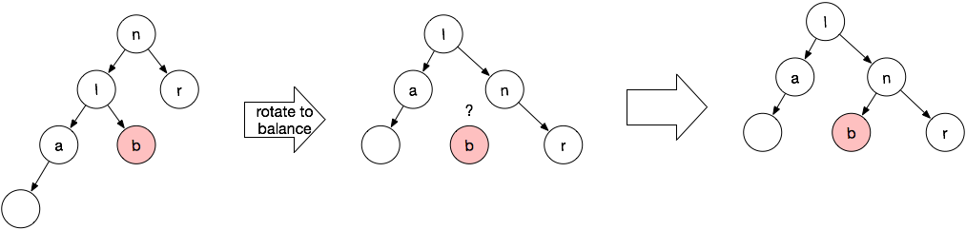
Right rotation: left child has two children
A right rotation on node n makes n the right child of n’s left child.
b is disconnected from l, but it can be reconnected as the left child of n, since it’s bigger than l and less than n.

Slide 27
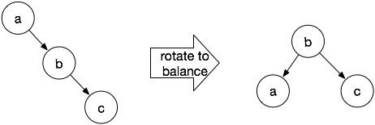
Left rotation
A left rotation moves nodes to the left. a becomes the left child of b, b takes a’s place.
In this case, b has no left child, so a can simply be reconnected there.

Slide 28
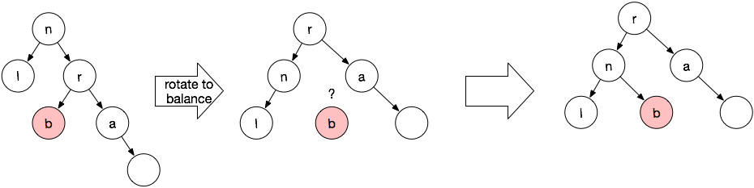
Left rotation: right child has two children
A left rotation on node n makes n the left child of n’s left child.
b is disconnected from r, but it can be reconnected as the right child of n, since it’s smaller than r and bigger than n.

Slide 29
When to rotate? (naive approach)
// after inserting (or removing) a node n
parent = parent of n
if the balance_factor(parent) == 2,
then more on left side so rotate right
if the balance_factor(parent) == -2,
then more on right side so rotate left

Slide 30
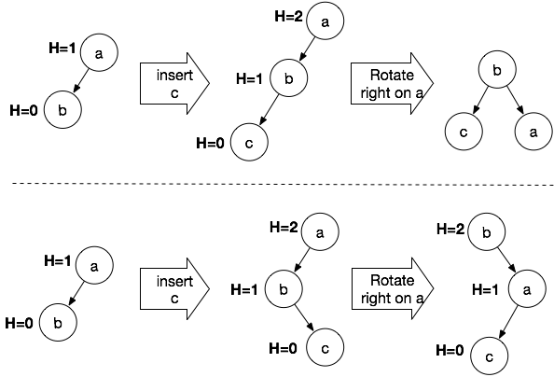
Doesn’t quite work out as planned
We get the effect we want, the tree is now balanced.
Whoops. We do not get what we want here; the height of the tree remains 2.
A single rotate right doesn’t work!

Slide 31
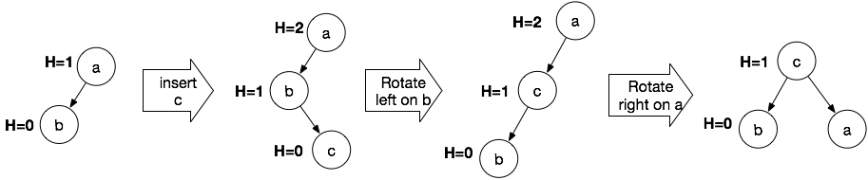
Works better if you rotate left first!
Rotating left on node b converts the tree into the shape we need for the rotate to the right to work!
Now we can balance the tree!

Slide 32
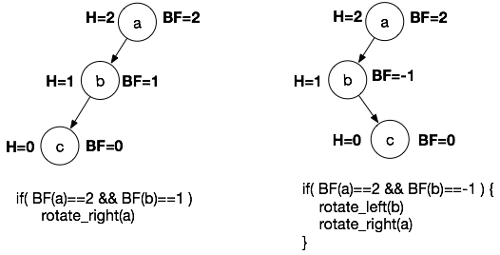
How do we distinguish these cases?
The balance factors allow us to tell them apart.
These patterns are often referred to by their balance factors: (2,1) and (2,-1)
There are analogous patterns going the opposite way: (-2,-1) and (-2, 1)

Slide 33
Balance Tree Pseudocode
void balance(node) {
if ( balance_factor(node) == 2 ) {
if( balance_factor(node->left) == -1 ) rotate_left(node->left);
rotate_right(node);
} else if ( balance_factor(node) == -2 ) {
if ( balance_factor(node->right) == 1 ) rotate_right(node->right);
rotate_left(node);
}
}

Slide 34
Balance upon Insertion and Removal
When we insert or remove an item from the AVL tree, we will ensure that the tree is balanced.
This requires balancing all of a node’s ancestors to ensure a BF<=1 at all levels of the tree
For insertion, use BST insertion, then balance the new node’s parent and all of its ancestors.
For removal, use BST removal, balance depending on the case:
Case 1 and 2: balance the parent of the node removed and all ancestors
Case 3: after swapping the node for its successor, balance the original parent of the successor and all of its ancestors

Slide 35
Summary
Heapsort works by repeatedly removing the maximum element to the end of the array.
Heapsort achieves O(log N) efficiency.
A sub-tree is unbalanced if one sub-tree has a greater height than the other sub-tree.
AVL trees attempt to maintain a balance factor of 0 or 1 on all nodes.
AVL trees rely on right rotation and left rotation to ensure balance.
There are four main cases that we must handle to balance a tree: (2,1), (2,-1), (-2,-1), and (-2,1)

Slide 36
References
1. ZyBook on Data Structures, chapters 16.13, 18.1-18.4

